Slide 1
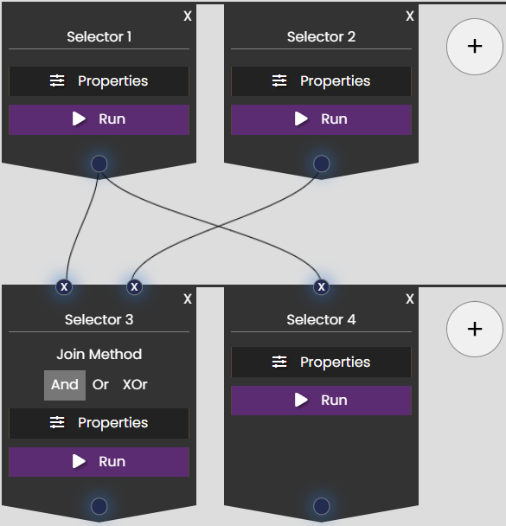
Give each Query a meaningful name, so you know what it‘s doing
Specify what results you want to query(what category, distance, etc)
Runs this query and shows you all results at the bottom of the page
Execution direction
Connect multiple queries to create subqueries based on previous results
Use different methods for joining previous Selections

